Slide 1
Research Project management 101
Chris HJ Hartgerink, January 22 2016
Notes:
Hi everyone,
Thank you for joining me today to talk about project management. I know it sounds boring and redundant, but fact is that NOT managing your project is much more frustrating than properly managing it is boring.

Slide 2

Notes:
Today, we will walk through several scenario’s with our dear friend Harold. Harold is a researcher just like us, and does projects just like us. Here we can see him reading a research paper at home.

Slide 3
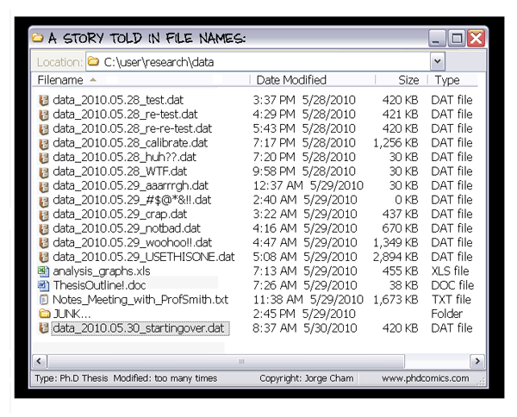
Notes:
However, one of his published projects looks like this. Just a bunch of disorganized files that all converge into a word document. And in his junk folder there are many older revisions of his word document.

Slide 4
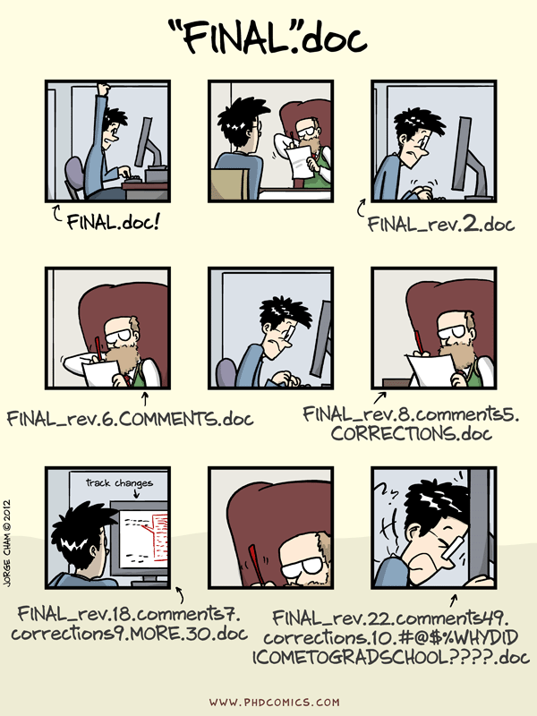
Notes:
We have to admit, we have all done this at some point. I remember that I was once at final^5 stage and accidentally edited final^4. Talk about the disaster that was.

Slide 5

Notes:
But now Harold gets a phone call, where it is announced that this project has been selected for a data audit.

Slide 6
DATA PACKAGE AUDIT
Notes:
But now Harold gets a phone call, where it is announced that this project has been selected for a data audit.

Slide 7

Notes:
Understandably so, Harold gets distressed. Many questions arise in his head

Slide 8
Which data selection?
Which secondary analyses?
Which datafile?
Which analyses?
Which covariates?
Which variable transformations?
Notes:
Understandably so, Harold gets distressed. Many questions arise in his head

Slide 9

Notes:
He decides to take a chill pill and sort his things out.

Slide 10

Notes:
He starts to think hard about what he did

Slide 11
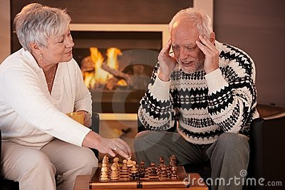
Notes:
He gets distressed plays chess with his wife to help him recover his thoughts.

Slide 12

Notes:
Ultimately, after a few days of working through all kinds of scenarios he has been able to reverse engineer his research results and he is ecstatic.

Slide 13
Notes:
And now Harold returns to his ordinary research life. But now he gets a data request for a meta-analysis for another project, and the whole cycle starts again.

Slide 14
DATA REQUEST
Notes:
And now Harold returns to his ordinary research life. But now he gets a data request for a meta-analysis for another project, and the whole cycle starts again.

Slide 15

Notes:
Harold finds out that this data is gone. Now Harold is starting to go crazy. Look into his eyes, you can see the crazy coming out.

Slide 16
Don’t be like Harold
Notes:
Let’s prevent us to become like Harold. Because honestly, these kinds of request can come from anywhere for any project and we as researchers are supposed to be able to share these kinds of things.

Slide 17
VSNU: Information presented must be verifiable. If research results are published it must be clear what the data and conclusions are based upon, where they have been taken from and where they can be verified.
Notes:
The Dutch association of universities, which we also fall under, has agreed the following as a professional standard. So we are professionally obliged to make sure we do not become like Harold. I am happy to see all of you here to ensure we do not become like Harold.

Slide 18
Ask ourselves continuously: Can my future-self or anyone else reproduce this result within a reasonable amount of time?
Notes:
So what is the most vital thing to prevent us from becoming Harold? If we ask ourselves whether we can reproduce the result within a reasonable amount of time, this goes a long way. What is reasonable, is of course dependent on what it is that you are trying to do

Slide 19
Ensure that project is...
Structured
Logged changes
Reproducible
Shared
(Continuously) backed-up
Future proof
Notes:
Of course, this is very abstract and is only a guide throughout the research. To make it much more structured for ourselves, these are several of the most important aspects of project management.

Slide 21
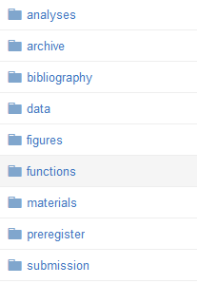
Structuring the project
Different folders for different aspects of your research

Slide 22
Structuring the project
Different folders for different aspects of your research
Minimize folder levels
data/study 1/pilot study/ is less clear than data/pilot study 1

Slide 23
Structuring the project
Different folders for different aspects of your research
Minimize folder levels
data/study 1/pilot study/ is less clear than data/pilot study 1
Try to prevent going three levels deep

Slide 24
Structuring the project
Datestamp time sensitive files

Slide 25
Structuring the project
Datestamp time sensitive files
Continuous data collection?

Slide 26
Structuring the project
Datestamp time sensitive files
Continuous data collection?
Emails/letters?

Slide 27
Structuring the project
Datestamp time sensitive files
Continuous data collection?
Emails/letters?
Want to be able to chronologically sort something?

Slide 28
Structuring the project
Datestamp time sensitive files
Continuous data collection?
Emails/letters?
Want to be able to chronologically sort something?
22 January 2016 →
20160122 filename.pdf

Slide 29
Would you feel confident giving your project folder to a co-author?

Slide 30
Logging changes
Some files obviously change
Syntax files
Manuscript

Slide 31
Logging changes
Some files obviously change
Syntax files
Manuscript
Some files obviously should not change
Raw data

Slide 32
Logging changes
Some files obviously change
Syntax files
Manuscript
Some files obviously should not change
Raw data
How to know if changes are made, what the changes are, and who made the changes?

Slide 33
Version control

Slide 34
Version control = track changes for files

Slide 35
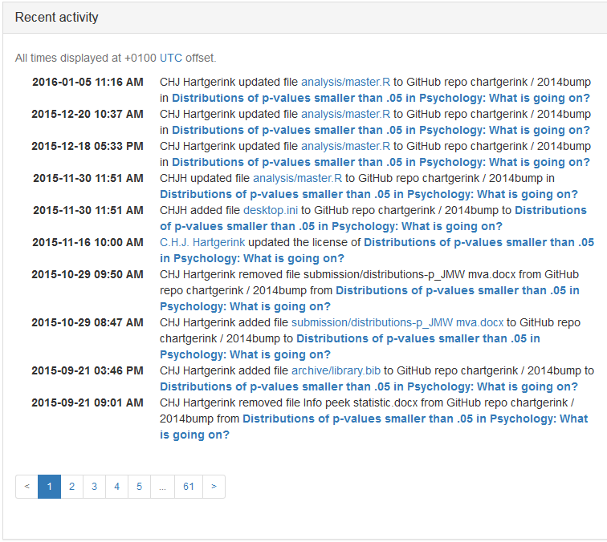
Notes:
At a meta-level, streaming changes.

Slide 36
Notes:
At a meta-level, streaming changes.

Slide 37
Notes:
At a meta-level, streaming changes.

Slide 38
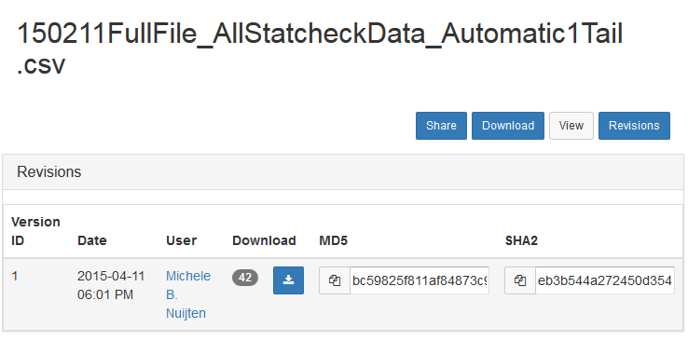
Notes:
Or file specific, allowing you to revisit and restore older version.

Slide 39
manuscript.pdf
manuscript_final.pdf
manuscript_final2.pdf
manuscript_final3.pdf

Slide 40
Timepoint 1
Timepoint 2
Timepoint 3
manuscript.pdf
manuscript.pdf
manuscript.pdf

Slide 41
How to version control
Open Science Framework (www.osf.io)
Pro:
Easy to use
Fully free (and will stay free)
Collaborative, online environment
Optional, free, statistical consulting
Pre-registration possible
Links to services such as Dropbox (effortless version control!)
Cons:
Servers located in the United States (watch out with sensitive data! European rights are not protected in the US)

Slide 42
How to version control
Want more advanced options?
E.g. Github
Talk to me about these if you’re interested!
More technical, but also more control

Slide 43
Notes:
At a meta-level, streaming changes.

Slide 44
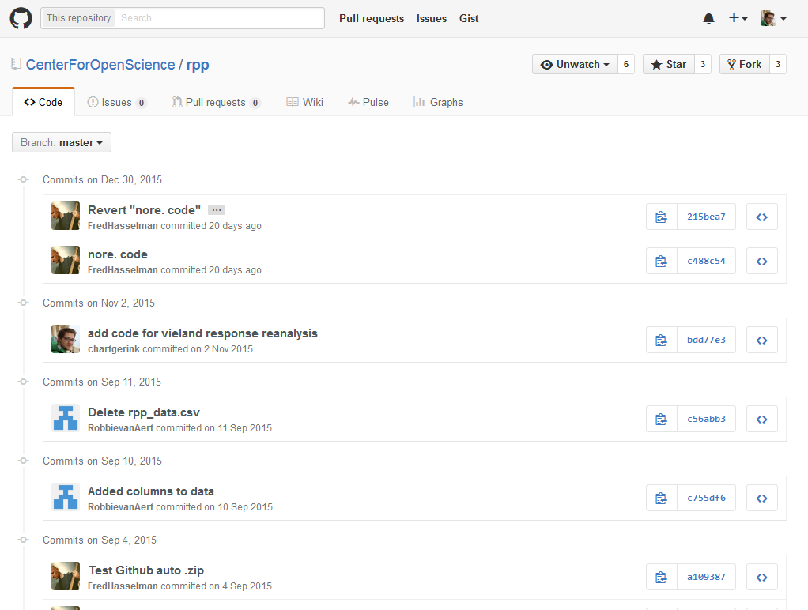

Slide 45
Can you provide a documented account of your process?

Slide 46
Sharing research
Sharing with co-author(s)
MANDATORY for data package (≥ 1)
Good practice
Check each other’s analyses
Check reported results for rounding errors (1/2 papers in psych contain error)
Sharing with everyone
Good practice → allows everyone to verify results
Becoming the new standard
Public preservation of research
Both possible with OSF
Notes:
Single author paper requires you to make it public to an outsider anyway, so making public for everyone is much more easy

Slide 47
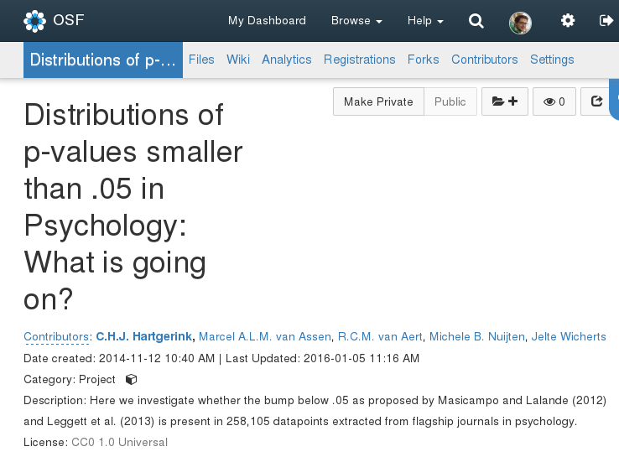
Notes:
Slides on adding co-authors and on making public

Slide 48
Notes:
Slides on adding co-authors and on making public

Slide 49
Are the research files directly available to someone else if you were to fall ill?

Slide 50
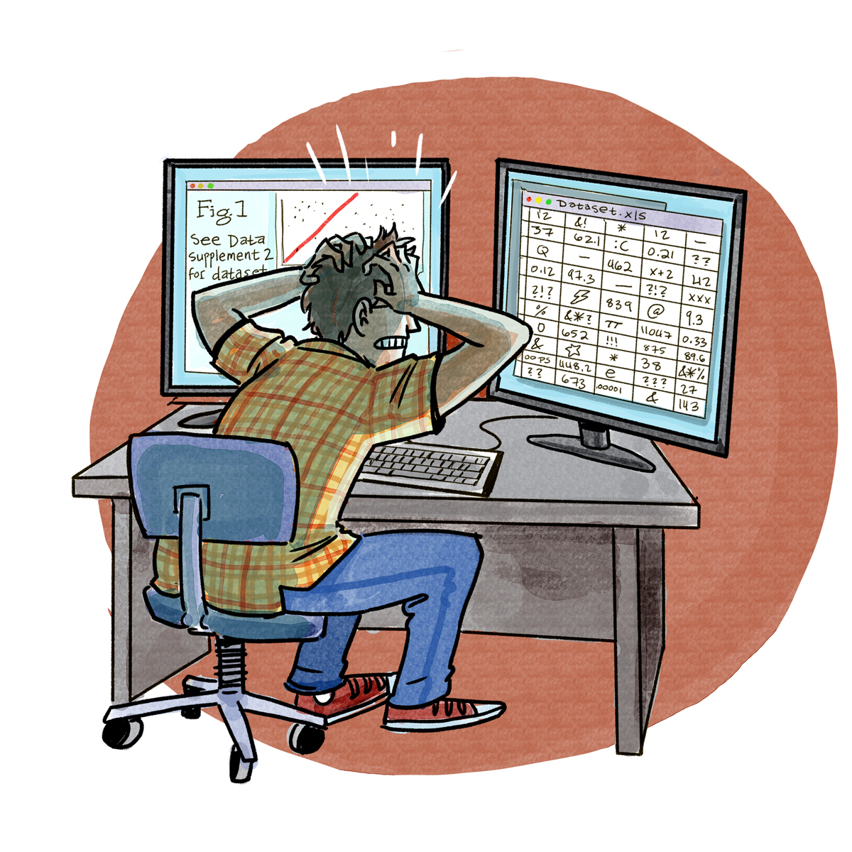

Slide 51
Reproducible
ALL steps from raw data to results
Use the syntax for everything
Reading in dataset
Variable transformations
Creating sum scores
How you handle missing cases
Etc.
Make it as easy as possible

Slide 52
Reproducible
Leave the least amount unclear
Using excel to calculate some new variable? ☹
Using graphical interface for SPSS without pasting the syntax? ☹
Not mentioning what software you used? ☹
Not caring about these things? ☹
Remember, you are shooting yourself (!) in the foot

Slide 53
Reproducible
GET
FILE='C:\Data\Full_Dataset_De-Identified.sav'.
DATASET NAME DataSet1 WINDOW=FRONT.
UNIANOVA anchoring1a BY expgender
/METHOD=SSTYPE(3)
/INTERCEPT=INCLUDE
/CRITERIA=ALPHA(0.05)
/DESIGN=expgender.
✓

Slide 54
Reproducible
GET
FILE='C:\Data\Full_Dataset_De-Identified.sav'.
DATASET NAME DataSet1 WINDOW=FRONT.
UNIANOVA anchoring1a BY expgender
/METHOD=SSTYPE(3)
/INTERCEPT=INCLUDE
/CRITERIA=ALPHA(0.05)
/DESIGN=expgender.
X

Slide 55
Reproducible
GET
FILE='C:\Data\Full_Dataset_De-Identified.sav'.
DATASET NAME DataSet1 WINDOW=FRONT.
COMPUTE anchoring_sum = anchoring1a + anchoring1b.
EXECUTE.
UNIANOVA anchoring BY expgender
/METHOD=SSTYPE(3)
/INTERCEPT=INCLUDE
/CRITERIA=ALPHA(0.05)
/DESIGN=expgender.
✓

Slide 56
Reproducible
GET
FILE='C:\Data\Full_Dataset_De-Identified.sav'.
DATASET NAME DataSet1 WINDOW=FRONT.
COMPUTE anchoring_sum = anchoring1a + anchoring1b.
EXECUTE.
UNIANOVA anchoring BY expgender
/METHOD=SSTYPE(3)
/INTERCEPT=INCLUDE
/CRITERIA=ALPHA(0.05)
/DESIGN=expgender.
X

Slide 57
Reproducible
GET
FILE='C:\Data\Full_Dataset_De-Identified.sav'.
DATASET NAME DataSet1 WINDOW=FRONT.
COMPUTE anchoring_sum = anchoring1a + anchoring1b.
EXECUTE.
UNIANOVA anchoring BY expgender
/METHOD=SSTYPE(3)
/INTERCEPT=INCLUDE
/CRITERIA=ALPHA(0.05)
/DESIGN=expgender.
ERROR
X

Slide 59
Reproducible
Future is dynamic documents
E.g., knitR, Rmarkdown
The effect of condition on the dependent variable was significant, F(`r result$df1`, `r results$df2`) = `r result$fvalue`, p = `r result$pval`.
The effect of condition on the dependent variable was significant F(1, 65) = 10, p = .002.
Interested in working with this, let me know!

Slide 60
Future proof
File formats matter
Reading word file from 1992?

Slide 61
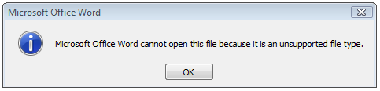
Future proof
File formats matter
Reading word file from 1992?

Slide 62
Future proof
File formats matter
Reading word file from 1992?
Reading text file from 1983? (oldest I could find)

Slide 63
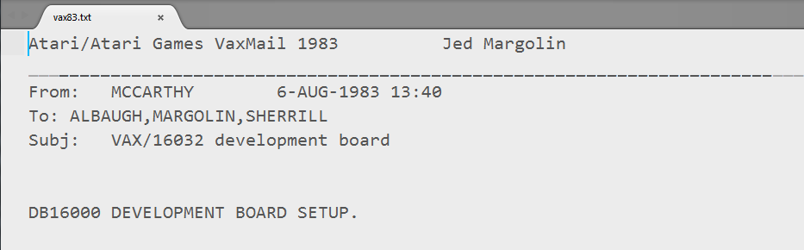
Future proof
File formats matter
Reading word file from 1992?
Reading text file from 1983? (oldest I could find)

Slide 64
Future proof
Proprietary file formats (.docx .xlsx .sav) not future proof
Changes in the software make these files difficult to read!
Companies do not make public how the format changed (“company secret” and “intellectual property”)
Open formats always readable
.txt
.csv
.dat
.odt
Save files in open formats

Slide 65
Future proof
Saving files in open formats requires almost no change
Just change the file format when saving

Slide 66
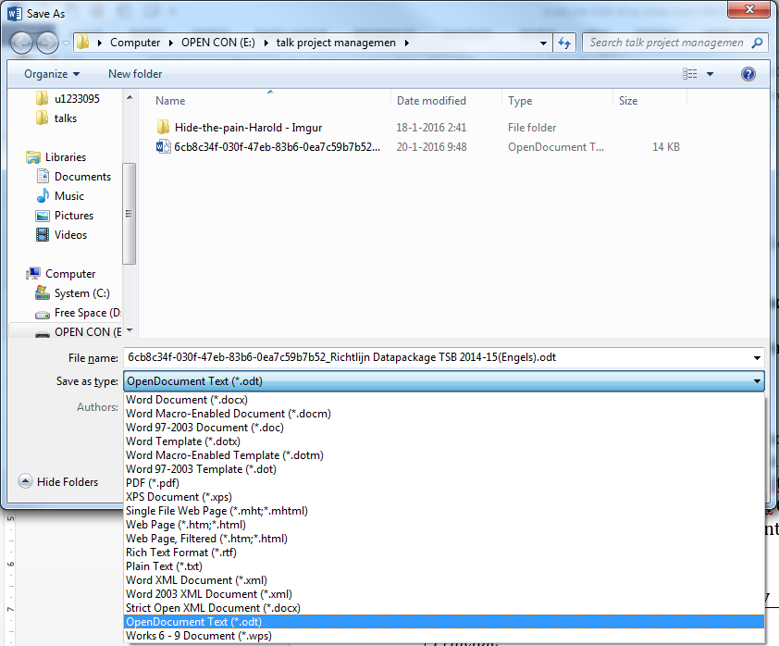
Future proof
Saving files in open formats requires almost no change
Just change the file format when saving

Slide 67
Future proof
Saving files in open formats requires almost no change
Just change the file format when saving

Slide 68
Future proof
Saving files in open formats requires minor change
Just change the file format when saving
Can still track changes, work with co-authors, etc.
PLUS future proofed.

Slide 69
Can you still use these files in 10 years?

Slide 70
Back-ups
Essential for preservation
Online + offline possibilities
Open Science Framework helps online back up
Continuous: link OSF with Dropbox, Google Drive, etc.
Manual: save files on the OSF
Offline backups remain important (sensitive data)

Slide 71
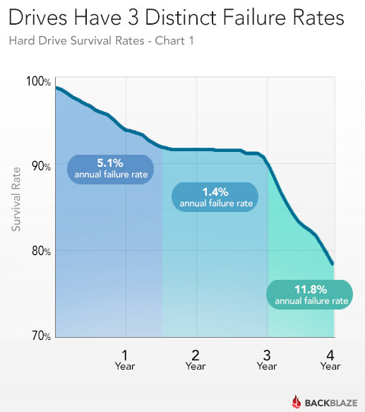

Slide 72
20% fail in 4y

Slide 73
If your hard drive is stolen, crashes, are you in trouble?

Slide 74
Ask yourself...
Are all research files collected in one place?
Are the research files organized?
Is it clear who did what in the project?
Are results and figures directly reproducible by others?
Are the research files available to co-author(s) or beyond?
Are your research files backed-up?

Slide 75
Data package
Mandatory in TSB!
Yearly audits of random sample of published papers
If you get audited, it *must* be in order
Option 1: Be like Harold
Option 2: Don’t be like Harold

Slide 76
Data package
Eight requirements
Metadata
Raw data
Data storage
Material
Statistical processing
Processed database
Access
Retention period

Slide 77
Data package
Eight requirements
Metadata
Raw data
Data storage
Material
Statistical processing
Processed database
Access
Retention period
✓
✓
✓
✓
✓
✓
✓
✓

Slide 78


Slide 79
Resources
Template project structure on the Open Science Framework: www.osf.io/4sdn3
Data audit guidelines https://www.tilburguniversity.edu/research/social-and-behavioral-sciences/download-guideline-datapackage-tsb/
I am always prepared to help out with reproducibility of research
chjh@protonmail.com
@chartgerink
P1.174B
Coffee machine

